Slide 1
Sorting Algorithms

Slide 2
Agenda Style
01
Sorting
Understand what sorting is
01
Bubble Sorting
Algorithm and code
01
Selection Sorting
Algorithm and code
01
Conclusion
Slight change in conclusion

Slide 3

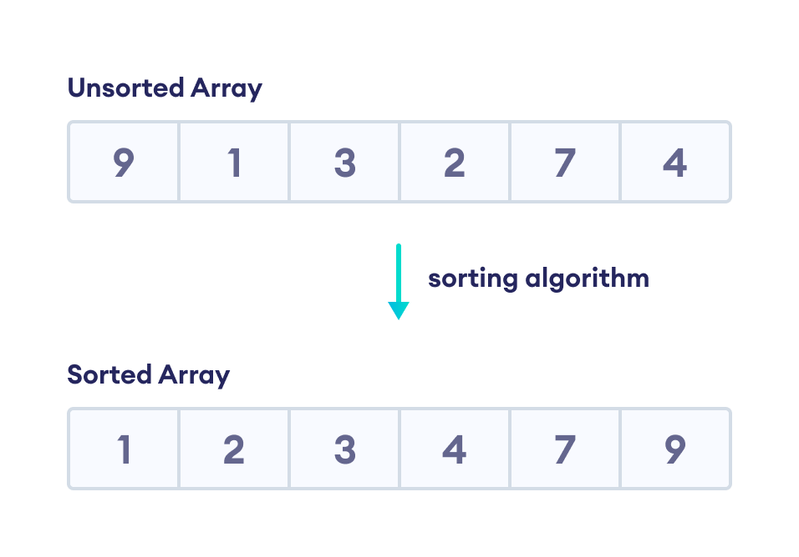
Sorting Algorithms
A sorting algorithm is used to arrange elements of an array/list in a specific order. For example,
Rearranging an collection (array) in ascending or descending order.

Slide 4
Bubble sort is a sorting algorithm that compares two adjacent elements and swaps them until they are in the intended order.
Just like the movement of air bubbles in the water that rise up to the surface, each element of the array move to the end in each iteration.
Therefore, it is called a bubble sort.
The details of the steps are:
First Iteration (Compare and Swap)
Starting from the first index, compare the first and the second elements.
If the first element is greater than the second element, they are swapped.
Now, compare the second and the third elements. Swap them if they are not in order.
Bubble Sort
Rearranging an collection (array) in ascending or descending order.

Slide 5
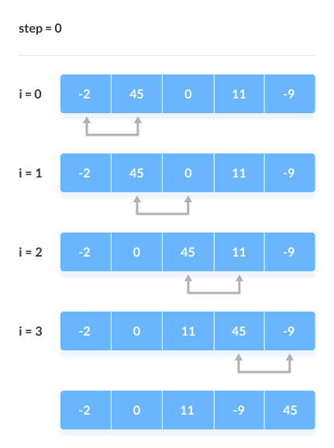
The above process goes on until the last element.
Sorting Algorithms
Rearranging an collection (array) in ascending or descending order.

Slide 6
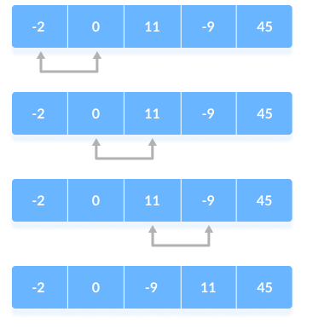
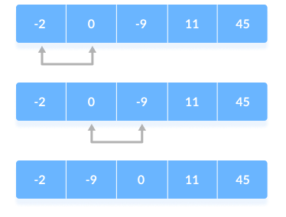
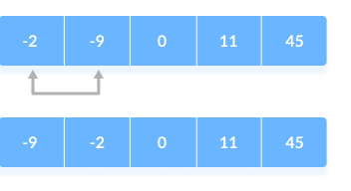
Remaining Iteration
The same process goes on for the remaining iterations.
After each iteration, the largest element among the unsorted elements is placed at the end.
Bubble Sort

Slide 7
Bubble Sort Algorithm
Bubble sort algorithm:
bubbleSort(array)
for i <- 1 to sizeOfArray - 1
for j <- 1 to sizeOfArray - 1 - i
if leftElement > rightElement
swap leftElement and rightElement
end bubbleSort
Rearranging an collection (array) in ascending or descending order.

Slide 8
import java.util.Arrays;
class Main {
// perform the bubble sort
static void bubbleSort(int array[]) {
int size = array.length;
// loop to access each array element
for (int i = 0; i < size - 1; i++)
// loop to compare array elements
for (int j = 0; j < size - i - 1; j++)
// change > to < to sort in descending order
if (array[j] > array[j + 1]) {
// are not in the intended order
int temp = array[j];
array[j] = array[j + 1];
array[j + 1] = temp;
}
}

Slide 9
public static void main(String args[]) {
int[] data = { -2, 45, 0, 11, -9 };
// call method using class name
Main.bubbleSort(data);
System.out.println("Sorted Array in Ascending Order:");
System.out.println(Arrays.toString(data));
}
}

Slide 10
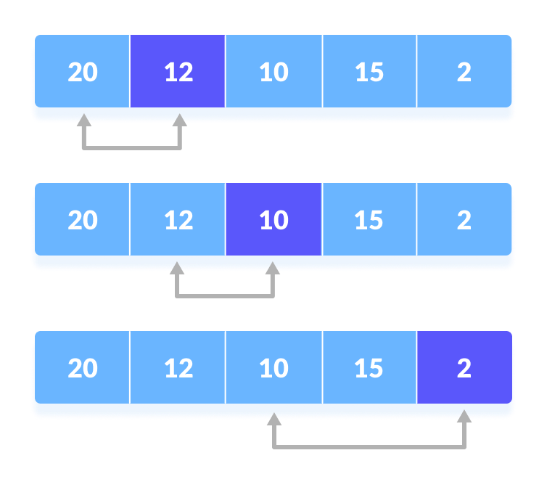
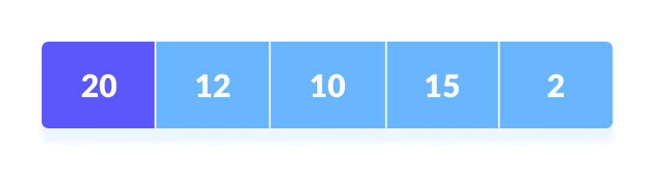
Selection sort is a sorting algorithm that selects the smallest element from an unsorted list in each iteration and places that element at the beginning of the unsorted list.
Steps:
Set the first element as minimum.
Compare minimum with the second element. If the second element is smaller than minimum, assign the second element as minimum.
Selection Sort

Slide 11
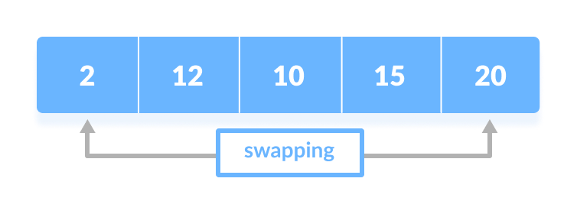
Compare minimum with the third element.
Again, if the third element is smaller, then assign minimum to the third element otherwise do nothing.
The process goes on until the last element.
After each iteration, minimum is placed in the front of the unsorted list.
Selection Sort
Rearranging an collection (array) in ascending or descending order.

Slide 12
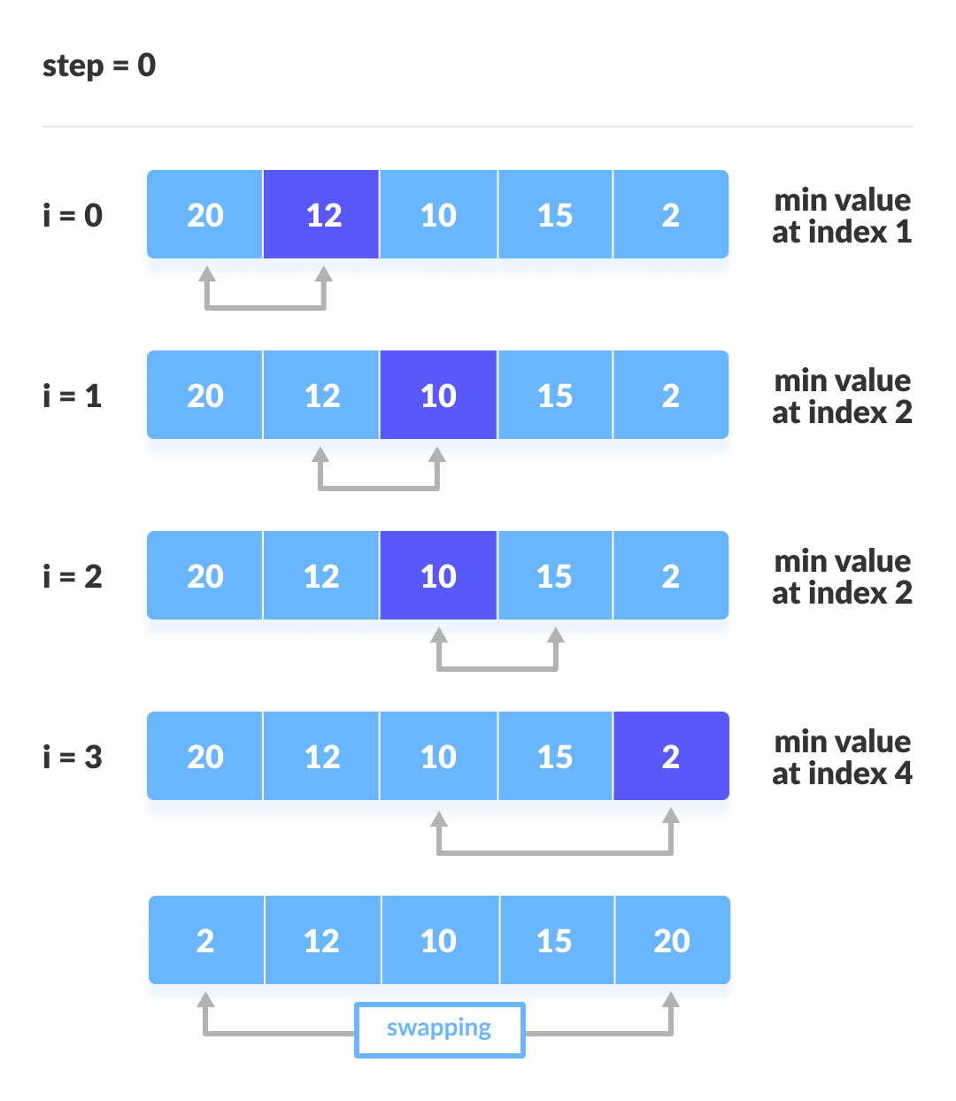
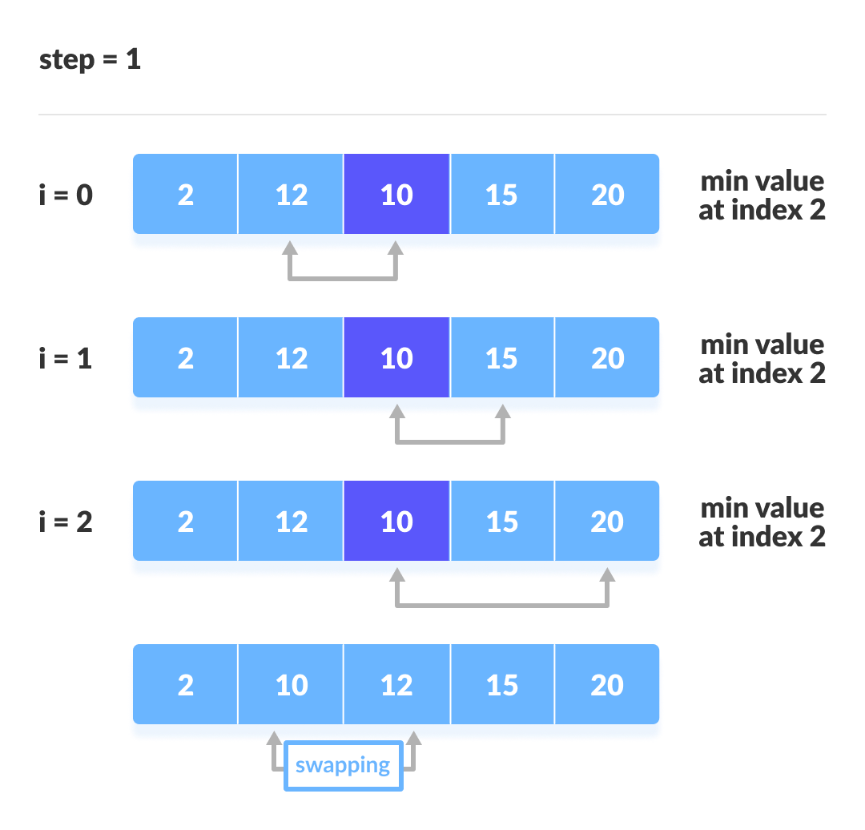

Slide 13
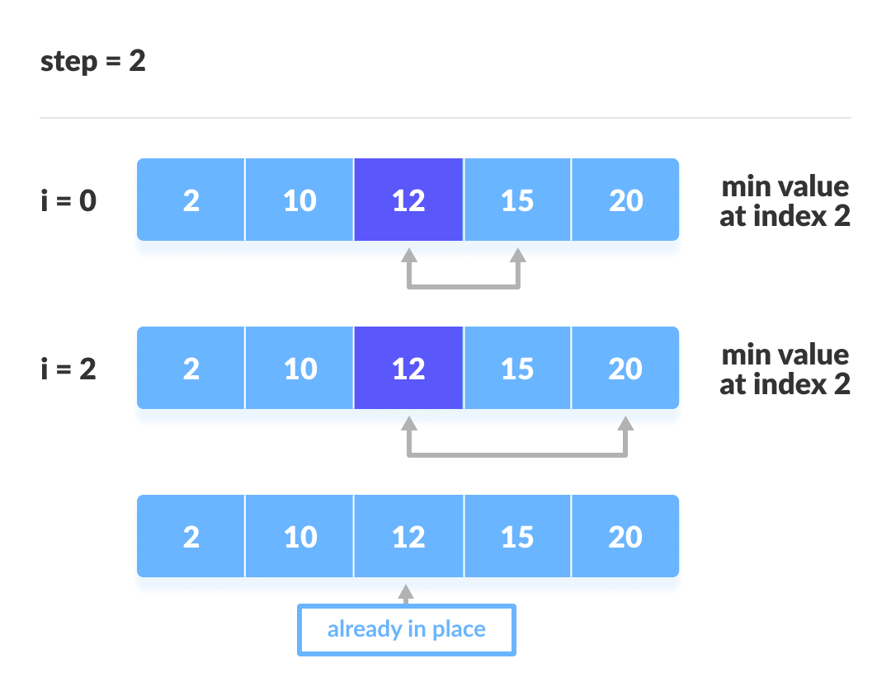
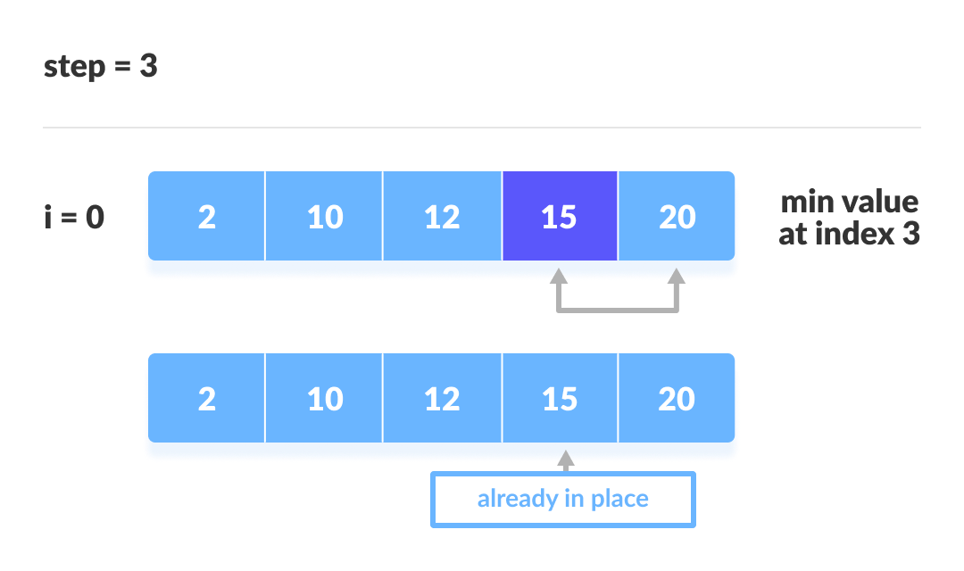

Slide 14
Selection Algorithm:
selectionSort(array, size)
for i from 0 to size - 1 do
set i as the index of the current minimum
for j from i + 1 to size - 1 do
if array[j] < array[current minimum]
set j as the new current minimum index
if current minimum is not i
swap array[i] with array[current minimum]
end selectionSort
Selection Sort

Slide 15
import java.util.Arrays;
class SelectionSort {
void selectionSort(int array[]) {
int size = array.length;
for (int step = 0; step < size - 1; step++) {
int min_idx = step;
for (int i = step + 1; i < size; i++) {
// To sort in descending order, change > to < in this line.
// Select the minimum element in each loop.
if (array[i] < array[min_idx]) {
min_idx = i;
}
}

Slide 16
// put min at the correct position
int temp = array[step];
array[step] = array[min_idx];
array[min_idx] = temp;
}
}
// driver code
public static void main(String args[]) {
int[] data = { 20, 12, 10, 15, 2 };
SelectionSort ss = new SelectionSort();
ss.selectionSort(data);
System.out.println("Sorted Array in Ascending Order: ");
System.out.println(Arrays.toString(data));
}
}

Slide 17

THANK YOU

